Slide 1
Altrincham FC Sponsorship 2017/18
Opportunities For:
Companies
Groups
Individuals
Altrincham FC

Slide 2
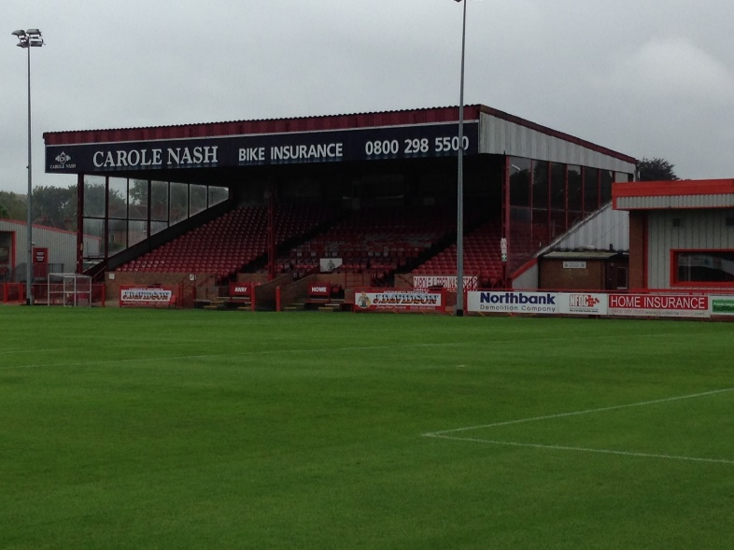
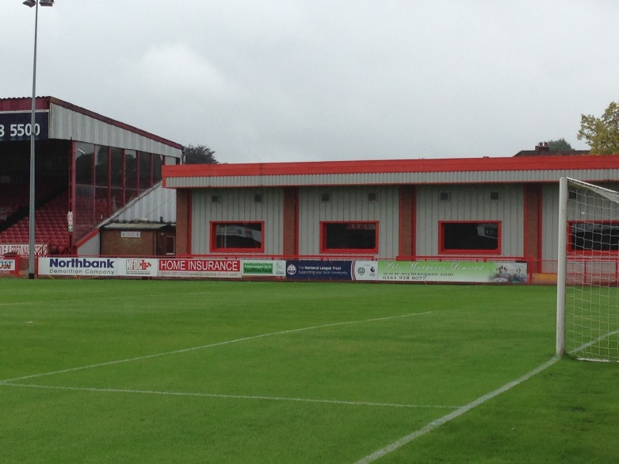
Corporate Sponsors - Ground
Main Stand Board
Prime Location for 3 Years
Featured on ALTY TV, MUTV, BT Sport
Perimeter Boards
Standard 24’ X 3’
Altrincham FC

Slide 3
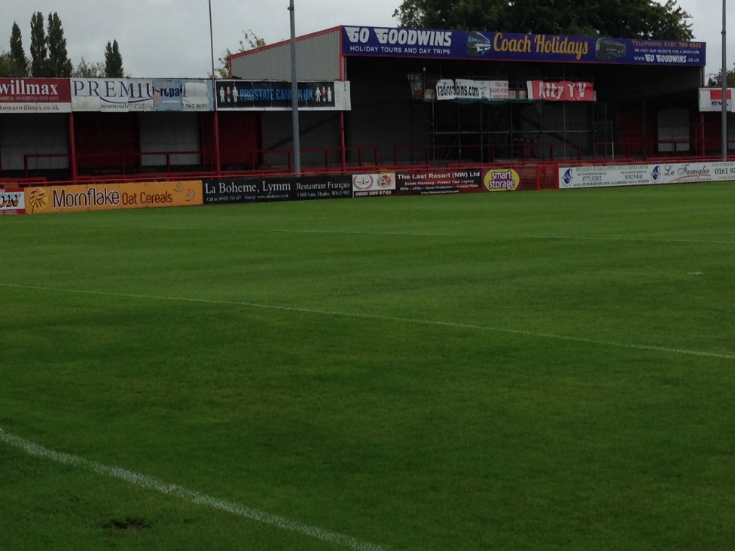
Corporate Sponsors
Advertisers Bond
Perimeter Board, Programme Insert
2 Season Tickets
Sponsor Bond
2 X Match Sponsor, 10 Reserved Seats
2 Season Tickets
Programme Advertising
23 Editions
Altrincham FC

Slide 4
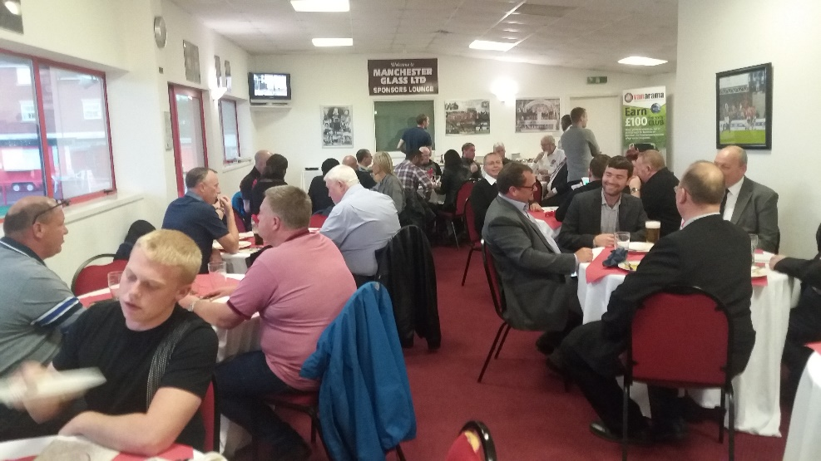
Match Day Sponsorship
Match Sponsorship
10 Guests in Sponsors Lounge
Pre-Match Meal, Drinks and Programme
Half Time Refreshments
Match Day Memento
Ball Sponsorship
2 Guests in Sponsors Lounge
Pre-Match Meal and Drinks and Programme
Half Time Refreshments
Match Day Memento
Signed Ball
Altrincham FC

Slide 5
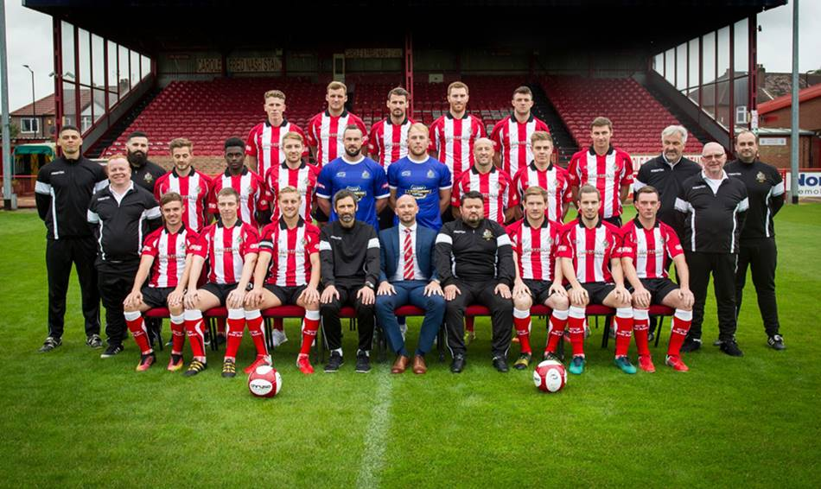
Other Sponsorship
Shirt Sponsor
Programme Advertisement
Sponsor a Player
Altrincham FC

Slide 6
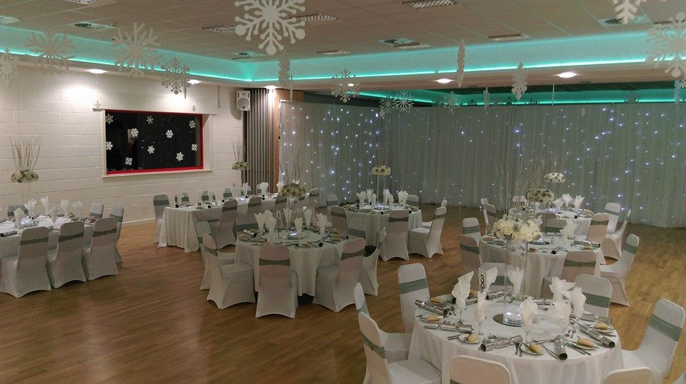
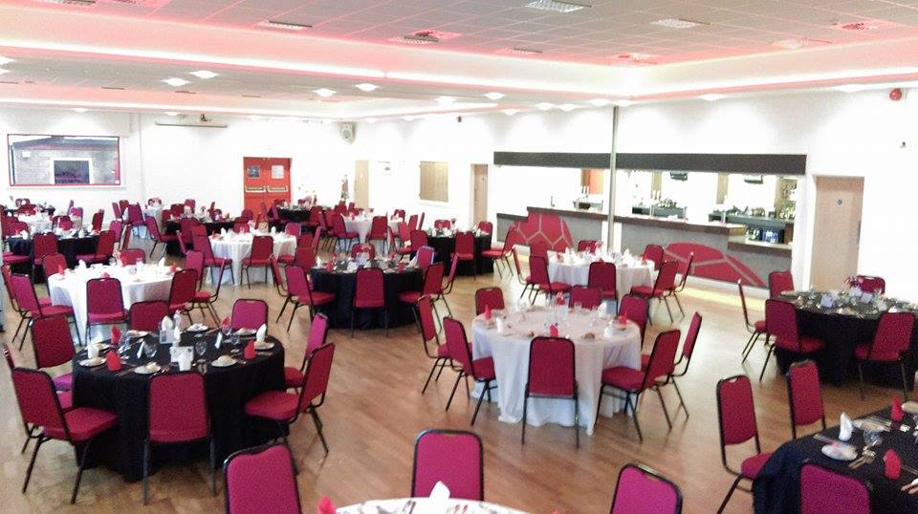
Hire The Community Hall
Birthday Parties
Christenings
Weddings
Sportsman's Dinners
Business Functions
Altrincham FC

Slide 7
Altrincham FC
Would you like to become a sponsor?
Know anyone interested in sponsorship?
Like to watch the match in style?
Then book a table in the sponsors lounge.
Give Noel a call on 07968 998285
Thank You for Your Support
Altrincham FC

